Slide 1
3D Vision Summer School 2023
Trimesh
Prayushi Mathur

Slide 2
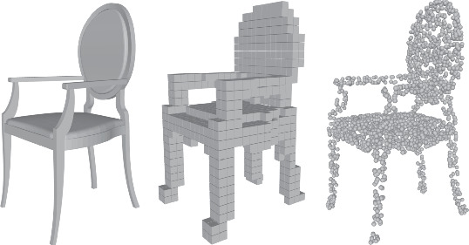
3D Object Representation

Slide 3
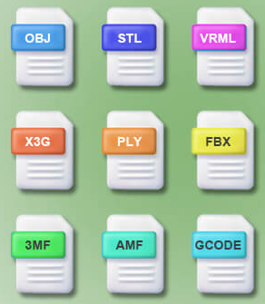
Different File Formats
OBJ
PLY
DAE
OFF…

Slide 4
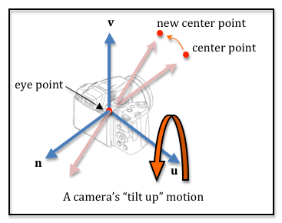
Camera

Slide 5
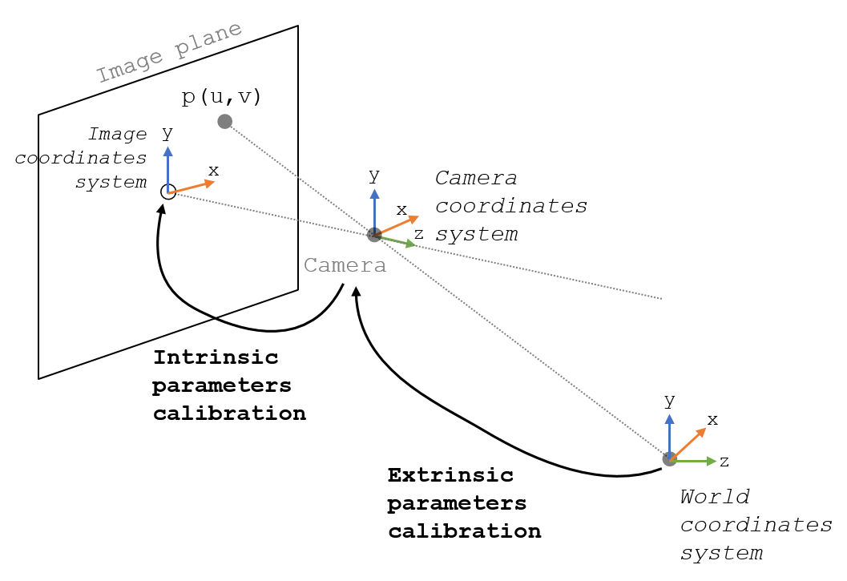
Camera

Slide 6
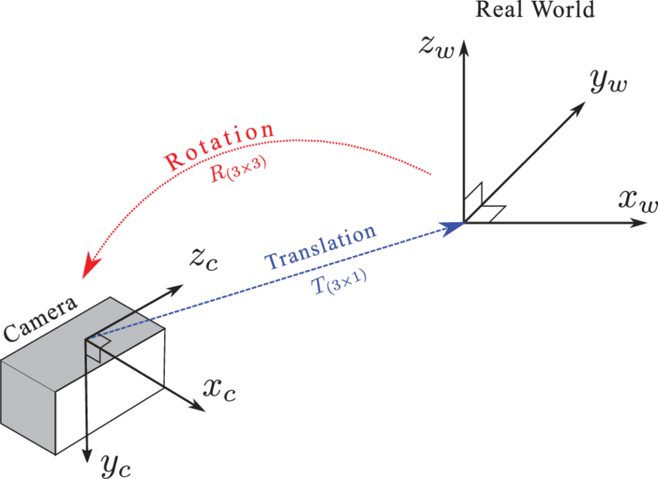
Camera Transformations

Slide 7
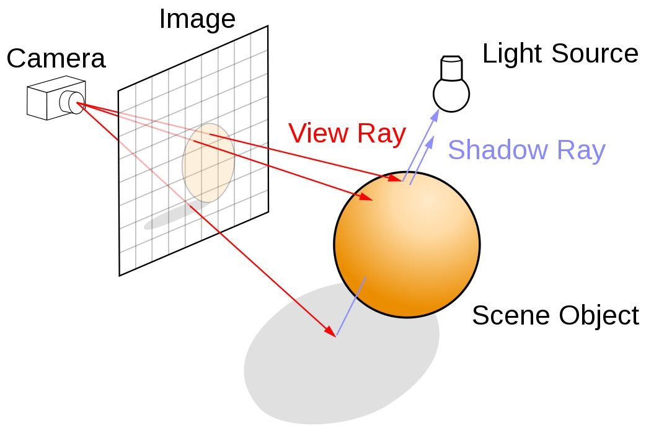
Ray Tracing
Ray tracing generates computer graphics
images by tracing the path of light from the
view camera (which determines your view
into the scene), through the 2D viewing plane
(pixel plane), out into the 3D scene, and back
to the light sources.

Slide 8
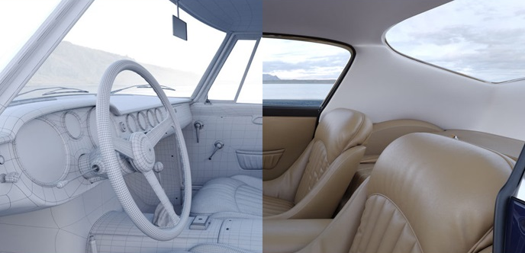
Rendering

Slide 9
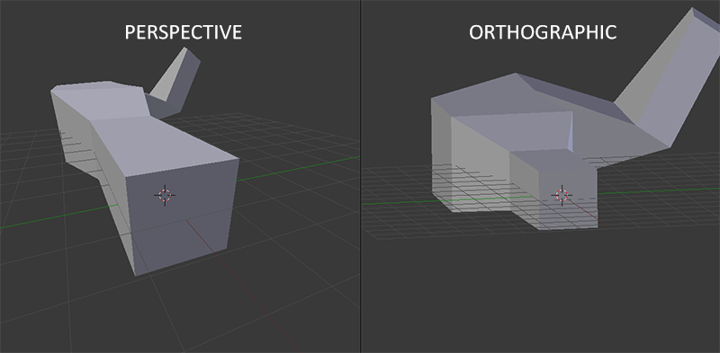
Orthographic Projection

